Slide 1


Slide 2
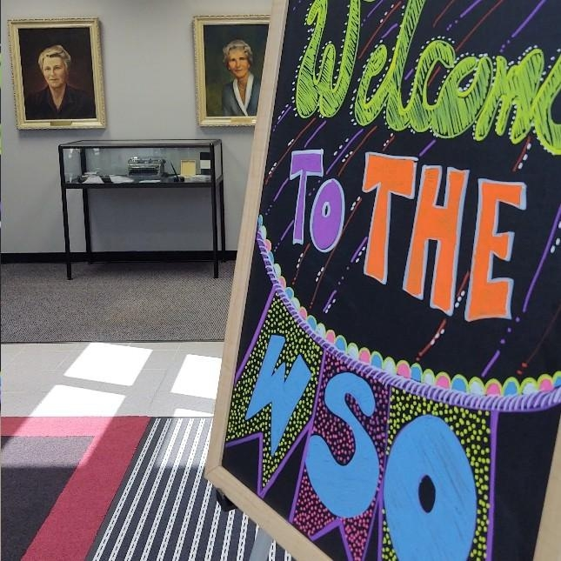
DELEGATE REPORT
Assembly October 20-22
Gwen Dinel, Panel 61
Ontario South, Area 86
Notes:
Hi Everyone !
My name is Gwen Dinel, I am currently serving as the Ontario South Area 86 Delegate!! I had the honour of attending the 63rd World Service Conference. This is the largest continual Al-Anon Group Conscience. This is the Business component of Al-Anon.
What does that really mean. Well, it means that I am the Service Link between Ontario South and the World Service Conference. In other words, I am going to do my best to share with you what was shared at Conference and since then. Following the Links of Service you then will take the information back to your districts & to your home Groups.
I am so blessed to be with you and I’m excited to see all of you. I have lots to share. So get comfortable and Buckle in and we’ll get started.

Slide 3

Notes:
I want to welcome everyone to the 2023 Assembly for Ontario South Area 86. Those who have been to assembly can offer love & encouragement to those that are here for their 1st time.
If you are new to your service role remember that year 1 is confused. Please know that we are all in this together.

Slide 4

If you have a question, please ask.
We want to hear your ideas.
We encourage you to participate.
Thank you for your Service !

Slide 5

WORLD SERVICE CONFERENCE 2023 Theme
Love, Laugh, and Grow Together
Aimer, rire et grandir ensemble
Amar, reir y crecer juntos
Notes:
The World Service Conference took place April 20-23 in Virginia Beach. What a wonderful experience it was for me to gather with all the other Delegates and World Service Staff. It was powerful, it was spiritual, it was fun and it was a lot of work! I was able to see the and experience the Traditions and the Concepts in action. We were definitely being guided by our collective Higher Power.
There was 4 jam packed days of information / conversation, voting, presentations, fellowship and a spiritual presence. The Conference started on Thursday. I Arrived the day before to attend the Annual Canadian Delegates Meeting on the Wednesday evening.

Slide 6
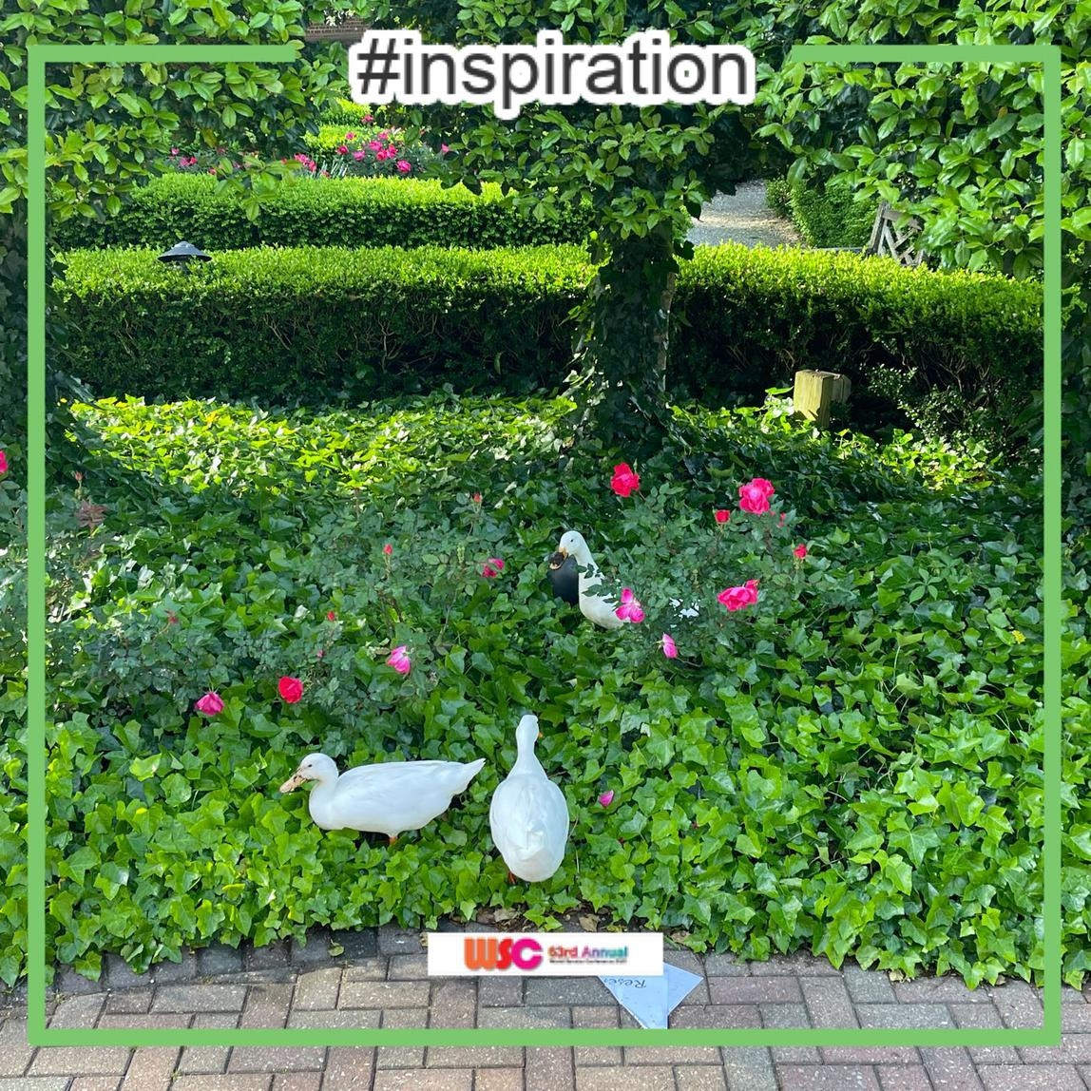
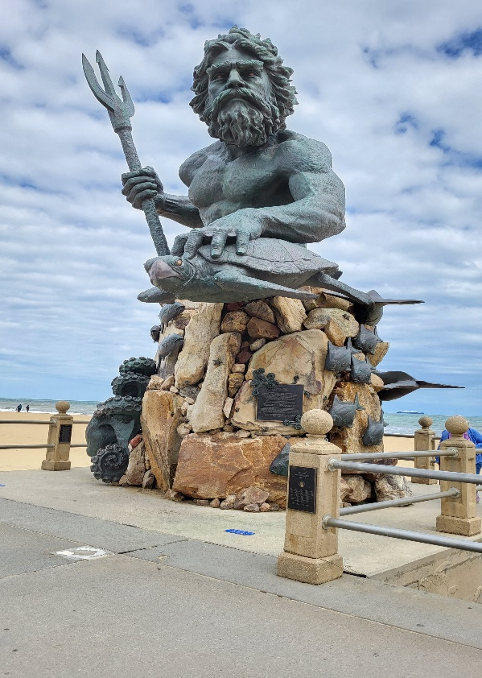
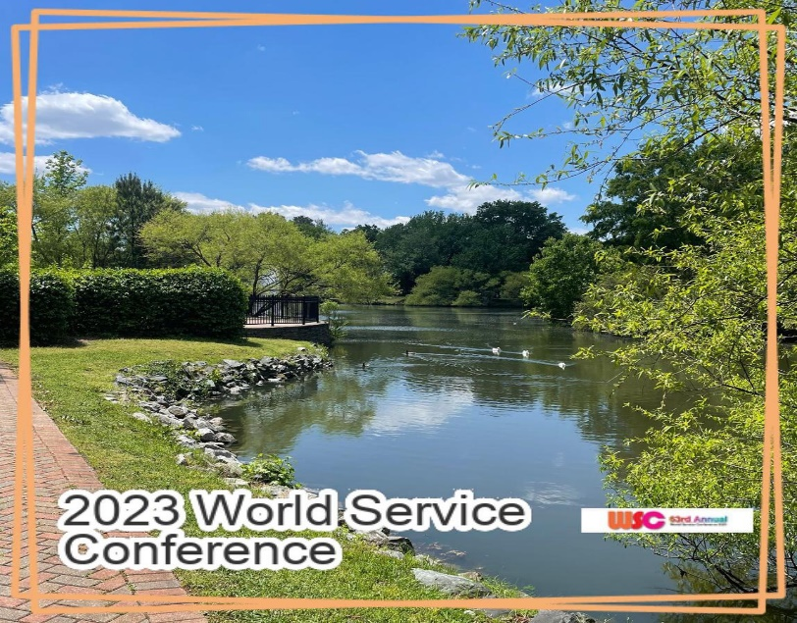
Virginia Beach
For most of the week the weather was in the mid 80’s.
Notes:
The conference was held at the Founders Inn. The grounds were stunning. The rose gardens were in full bloom, it was week 2 of strawberry season, everything was so lush and green.

Slide 7
Our Agenda Was Full Everyday
8:00 am – to 8:45ish pm
Area Highlights
Procedures and Etiquette
Panel 61 & Panel 62 Charges
Outgoing talks
Chosen Agenda Items
Director’s Reports
Open Board Meetings
Spiritual Speakers
Entertainment!!
Notes:
Thursday through Sunday. The days were long and they were loaded with information. Presentations were followed by Q & A. Any questions that did not get addressed were given an opportunity to be asked at the end of the day. And then, following that there were optional Al-Anon meetings each day at 6am and 9 pm ish. Here is just a sampling of things we did that I won’t go into detail about unless you want me to. Area Highlights – Each delegate was asked to submit a 400 word summary of successes and concerns and I have that entire document. We had an Area Highlights activity that all the delegates participated in.
On Thursday while the new delegates (Panel 63) were in the orientation meeting, the other two Panels (61 & 62) met separately and were given a charge that would be presented to the Conference later in the day. Over the 4 days all of Panel 61, my panel, was given the opportunity to give their 3 minute outgoing talk – that’s me up there giving mine. The Conference had two chosen agenda items for discussion. We attended two open Trustee Board meetings, as observers. We had a Trustee share their EXP at our opening lunch on Thursday. Sunday after dinner we had 2 members of Panel 61 Share their Spiritual journey in service. They were all very moving and inspirational. Following dinner and the 2 speakers on Sunday there was entertainment. This was provided in the way of a skit by my outgoing Panel (61). I can’t believe I’m going to say this, but it was a blast ! Ours was so funny!!!
I think the takeaway for you is that we worked hard and we had fun too. It was busy and a blessing in so many countless ways!

Slide 8
What Services Does the Budget Provide For???
Registering Groups
CAL
Mobile App
PSAs
Questions / Concerns Regarding Meetings
Questions and Concerns in General
Translating Literature
Supporting International Structures
Trilingual Online Store
Forum, Le Lien, en Accion
WSC
Interpretation
Alateen Recertification
Protecting Al-Anon’s Name / Brand
Website
Updated and Translated Guidelines
Membership Survey
Salaries, Building Expenses
Notes:
I want to assure you, that the WSO staff work HARD and with so much passion and dedication to provide the services we expect from WSO as well as forging ahead to provide future needed services.

Slide 9
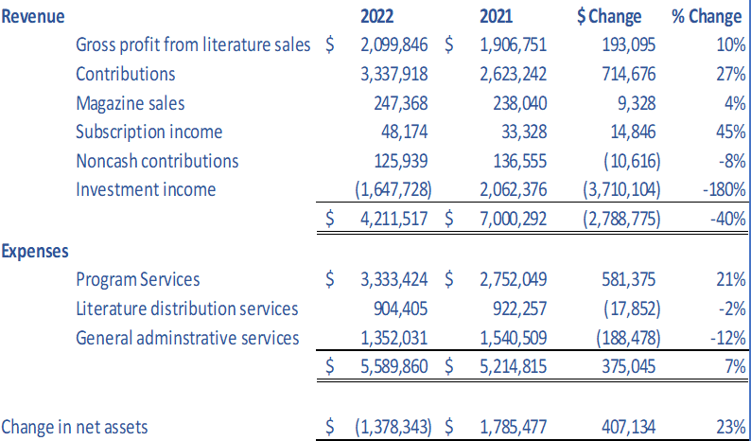

Financial Picture
Notes:
So now that we’ve talked about what WSO does with our contributions,let’s get into the financial aspect of AFG. We got a copy of the audited report. The WSO finances get audited every year and again we got a Clean opinion – that’s good! Contributions in 2022 were the highest ever - $3.3 million!! Literature sales are coming up, better than last year ($1.9 mil) but not as good as pre-pandemic. Our expenses come mainly from three areas, program services, literature distribution services, and general administrative services.

Slide 10
Top 10 Selling Book/Booklets of 2022
Notes:
Some statistics around the most purchased CAL. These are also available in French & Spanish.

Slide 11
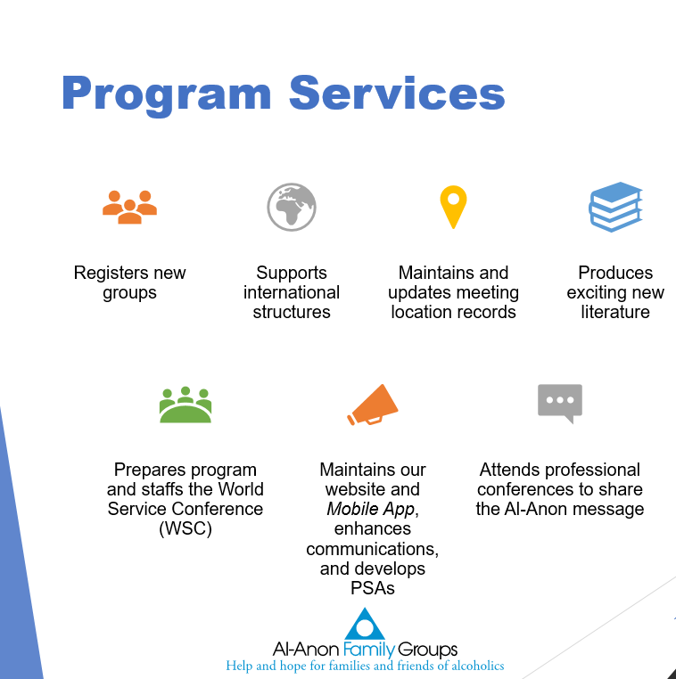
Expenses:
What does WSO do to support AFGs?
Notes:
Here is an overview of the program services. These are services that benefit all groups and this is the largest part of our expenditure.
So your Takeaway – Our finances are audited every year and presented for transparency. Contributions were great in 2022. Literature sales are getting better.

Slide 12

In short; To Bring it all together
We had a Clean Opinion on Audit
2022 highest year of contributions in history of the organization!! $3.3 mil
Literature sales came up in 2022 but still below pre-pandemic levels $2 mil
Sources of revenue: Contributions 52%, Literature sales 37% - 90% of revenue
Investment income – 2022 losses due to stock market
Expenses – Program services is the biggest expense
Notes:
We had a Clean Opinion on Audit
2022 highest year of contributions in history of the organization!! $3.3 mil
Literature sales came up in 2022 but still below pre-pandemic levels $2 mil
Sources of revenue: Contributions 52%, Literature sales 37% - 90% of revenue
Investment income – 2022 losses due to stock market
Expenses – Program services is the biggest expense

Slide 13
Notes:
The reality is this: Al-Anon World Service Office does not send groups a request for financial support. Instead, WSO shares with us the cost to support Al-Anon Family Groups. Their hope is that groups will send contributions based on the cost to support the group.
The quarterly appeal letter is not for groups. The appeal is to individual members.

Slide 14
Over All Totals
% of Average
Total # Groups Groups For Groups
Groups Contibuting Contibuting Contributing
2022 WSC Structure Summary 13,318 $8,098 60.80% $208.33
2021 WSC Structure Summary 13,841 $7,179 51.87% $174.58
Estimated cost of services provided $ 4,278,435
Average cost of services per group $ 321.25
Notes:
Here are the totals. Please take these figures back to your GR’s. It was even suggested that our groups could hold a business meeting to discuss how to set a budget.

Slide 15
Budget for 2023
A balanced budget!!!
Expenses for 2023 - $5,860,430
  Technology related to Electronic meeting transformation
  AFG Mobile App upgrade and website
  Planning for International Convention
  2023 World Service Conference
  International Structures meetings
Estimated Income for 2023 - $5,860,430
  Projecting literature sales to be $3.5 million
  New Daily Reader A Little Time For Myself ($17.00)
  Contributions to pre-pandemic levels – $2.5 million
  No plans for special appeal this year
Notes:
So here’s some good news! Board treasurer presented the budget for 2023 and it is a balanced budget. She went through the expected expenses for 2023, which will include some technology updates, especially with the electronic meeting transformation, updating the group records application – which is a big deal and will be done in parts, and refreshing the mobile app. As for the international, that will be self supporting but the planning for it does involve a lot of staff time. And of course our conference was an expense. The Equalized amount each delegate pays does not cover all the costs of the conference. So the total expected expenses are $5,860,430. and the projected revenue? $5,860,430. They are projecting literature sales to be $3.5 mil, with LDCs re-opening, less shipping and paper delays, and the sale of the new book. WSO is predicting contributions to be $2.5, not as much as last year but still consistent. And no plans for a special appeal.

Slide 16
Year to Date (YTD) June
Revenue
2023 YTD Actuals YTD Budget
Literature Sales—net $1,381,119 $1,078,613
Contributions $1,407,775 $1,183,436
Other income $3,153,649 $2,541,349
Total Expenses $2,828,928 $2,930,215
Net Increase/(Decrease) $324,721 ($388,866)
Notes:
As you can see, we are a little off the mark at the mid point of the year. Please consider sending WSO whatever your group can afford. Every dollar counts. It is also suggested that your groups add WSO as a line item in your annual budget.
So your TAKEAWAY? Please Continue to support your WSO with contributions and buying literature through our LDC.

Slide 17

Ontario South Contributions to WSO
Ontario S Area 86
C$ US$ C$ US$ 2022 $ 2021
126.22 94.67 Group 45,776 34,332 32,440
Other 28,686 21,515 13,335
49% of groups contributed
Average amount for groups: $126.22
* “Other” include contributions from AISs, LDCs, and Areas and individual members. Member contributions are captured by state rather than Area.
Notes:
Here is how Ontario South financially supported the WSO to support AFGs.
To date in 2023, 89 groups have contributed $15,612.75 CNDN That works out to $175.42
Remember that it was previously established that it costs WSO $321.25 to support each group.

Slide 18
Group Budgets Revisited
Group expenses (rent, GR expenses, literature given to newcomers)
Group contributions to service arms based on budgets
Total Expenditures:
Average number of members:
Average per week per member to be fully self-supporting:
WSO slide
Notes:
Let’s not forget the spiritual nature of our program. We have voluntary contributions, not expected payments. We know that not everyone is able to contribute, and that’s fine. We it is suggested that you give what you can.
We know that not all groups contribute and some groups give more than their share, because of the abundance of the group. Abundance is one of the spiritual principles at work in all of our finances. Your Takeaway? The 7th Tradition needs to include supporting your service arms as well as your group.

Slide 19

Diversity, Equity, Inclusivity Workshop
OK, Lets switch gears a little
Board of Trustees’ initiative to continue looking at DEI
Diversity, Equity & Inclusion
“I’m a Good Person! Isn’t That Enough?” by Debby Irving
Author of Waking Up White
Notes:
The Board of Trustees is looking at DEI – that is, Diversity, Equity and Inclusivity opening up an ongoing conversation. The Board participated in a workshop in January. They made the decision to share the workshop with the delegates at the World Service Conference. The workshop was presented by Debby Irving, author of Waking Up White. And the title of our workshop was I’m a Good Person! Isn’t That Enough? It was a powerful and emotional workshop. The idea was to broaden our scope and our perspectives around inclusion. It asked us to rethink our past assumptions and beliefs. What was the takeaway for me? That the Board is committed to continuing its consideration of DEI. It is a start and we have a long way to Grow. I believe that our collective Higher Power will lead the way and help us to envision the future of who will be attracted to Al-Anon.

Slide 20

ICC – International Coordination Committee
Team North: Norway, Latvia, Lithuania, Netherlands
Team East: Turkey, Bulgaria, Hungary, Switzerland
IAGSM in London ( International Al-Anon General Service Meeting)
Zonal Meetings coming up
  European – France in September – in person
  Ibero-America in October – virtual
  Central American and Carribbean in November - in person
WSO is the Senior Service Entity
Notes:
Both teams gave a great presentation about their visits to these countries, their support for these service structures, and the kinds of concerns these structures had, often similar to our own concerns. They have hired a new director of ICC, Tanya J., She had submitted her resume for Trustee. After careful consideration WSO offered her the role of Director of ICC for all of these general service structures throughout the world, some well established, some developing, and some just beginning. WSO is the senior service entity. They decided to have more frequent meetings and town halls to support some of these structures. What can you share? Al-Anon is growing and is really and truly becoming a World Wide Fellowship with the ongoing help and encouragement of WSO. Because of type of outreach the Director from the Germany came to out WSC. She was invited with voice and no vote.

Slide 21

Literature Motion
Motion: to give conceptual approval to develop a comprehensive piece on sponsorship and service sponsorship using personal sharings.
MOTION PASSED!
Notes:
For me this was very special. Sponsorship has played a huge role in my recovery, both as a sponsee and a sponsor.
As we know, nothing happens quickly in Al-Anon. The new daily reader being débuted at the International in July was passed as a motion 9 years ago!

Slide 22
Transforming Electronic Groups
This work has been mammoth in scale!
Electronic Groups can register and transfer using the online forms
Global Electronic Meeting Search
  Live March 10, 2023
  Driven by user’s time zone
  Listed in chronological order
  Can search by name, platform, day, etc
  Can print results
  Registered Electronic Groups only, in Global Electronic Area (GEA)
What about Geographic Electronic Meetings???
Notes:
Transforming Electronic Groups – I am not going to spend too much time on this topic. The Task Force will be reporting to you with regard to groups in Ontario South.
This has been a huge undertaking that started before the Motion to allow electronic meetings to be electronic groups in 2021.
The move forward with accepting the Global Electronic Area into the WSO Service Structure has been moving full speed (remember its Al-Anon) ahead this year as more and more Electronic Groups register and more and more Areas allow Electronic Groups to be a part of their Area. Right now, there are forms on the WSO website that an electronic group can register or submit a change. As of last month, these forms are online only, not printable to submit by mail. The Global Electronic Meeting Search went live on March 10, 2023 and this has been no easy undertaking. The search is driven by the user’s time zone; if you are in central time, it shows all the meetings in that time zone. It lists them in chronological order but it is searchable by name, platform, day, time, focus, etc. Now this search engine is only for registered electronic groups and those in the Global Electronic Area. So what about electronic groups that are attached to a geographic area?

Slide 23
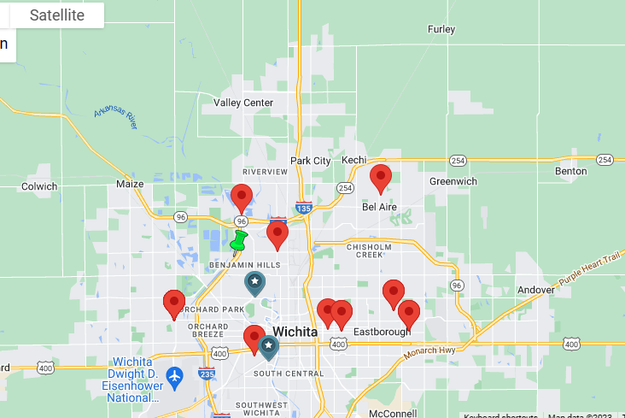
Geographic Electronic Meeting Search
Work in progress
Plan - Use zip codes
Put pin in map at water, park, intersection – non-residence
Color coded for physical groups and electronic groups
For registered electronic groups in a geographic area
Notes:
This geographic electronic meeting search is a work in progress. Currently these meetings can be found by accessing our the World Service website. This is how WSO is hoping to incorporate geographic electronic groups into the meeting search. They plan to use the zip code of the CMA. They will put the pin, a different color, into a non-residence in that zip code – water, a park, an intersection, something that will not give an address to go to. This will be for electronic groups that are registered to a geographic area.

Slide 24

What about temporary electronic groups??
Hmmm…
Notes:
So what about a group that has been temporarily meeting electronically and haven’t gone back to face to face. Up to now, there has been no timeline for these groups. But as these procedures are developing, WSO is asking these groups to decide either become electronic groups or go back to physical groups by 6 months to a year from when the area passed procedures for allowing electronic groups. For us in Ontario South this is still a work in progress. One major factor – consider what audience you want to attract? If you want a global audience, you might want to join the Global Electronic Area. If you want to attract a local audience and if you want to participate in the local service structure, your district, your area, then consider changing to an electronic group. This would involve just a change form. Your group records coordinator can help you with that. Now how about what we previously referred to as hybrid meetings? We are now calling these Physical Groups with an Electronic Component. How long can they remain meeting in this format. Well, the question was asked and the response was – as long as they wanted.
What can you report back?
Transforming electronic groups is a major undertaking at WSO. The Global Electronic Group Search is functional and easy to use. WSO is working on how to search for Geographic Electronic Meetings, possibly using the zip code. If your group is a temporary electronic meeting registered as a physical meeting, you need to start considering whether to stay electronic or go back to physical. If you are a Physical group with and electronic component – continue as you are based on your group conscience.

Slide 25

Hang in there
I know this is a lot but we’re getting there

Slide 26

Annual Report
Chairperson of the Board – Lynette talked about staffing. There are currently 46 positons and they are hoping to add at least 3 more staff.
Niketa – Director of Finance & Operations (as required she is an Al-Anon member) reported our finances and talked about the costs of translating our literature in Spanish and French. She also gave us a very detailed report on finances.
Scot Powers – Director of Communications and Community Awareness – Shared info about the Mobile Ap, Electronic Groups and the International.
Sara Smith – Director of Programs
Notes:
The Annual Report is one of my favorite parts of the conference. Each staff member that heads a department gets to share what they’ve been doing. I have a copy of the Annual Report if you would like to see it and it will be available soon on the website. Go to members then to WSO and you’ll see Annual Report on that page. You will find that the Annual Report aligns very closely to the Mission and the Strategic Objectives. At the conference, the members really just gave an update since January since the Annual Report covers 2022. The Chairperson of the Board, Lynette, talked about the staffing. They have had some staff retire, move on to other opportunities and the Loss of Chris Baker. This was a tough loss for anyone that knew Chris. He will be missed. Niketa, who is the Director of Finance and as such, not a member of Al-Anon, talked about the translation efforts – this is a huge thing for WSO, to get everything translated into French and Spanish before it comes out. Scott talked about the mobile app – we’re up to 125,000 members! They are working on an upgrade for the app.

Slide 27
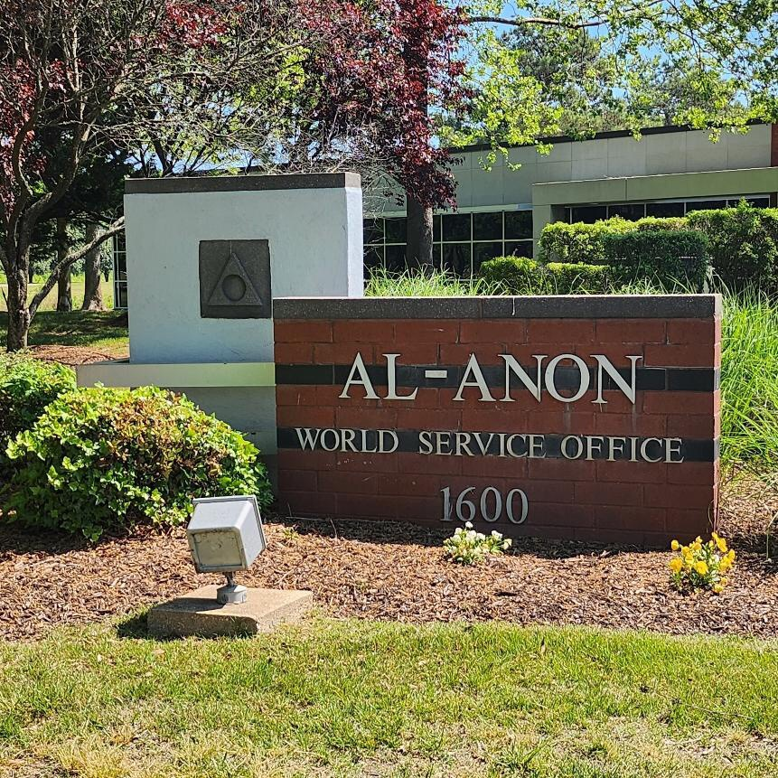
WSO VISIT
OUR WORLD SERVICE OFFICE
Welcome Home !!
Notes:
Once every three years, Delegates have the opportunity to visit OUR World Service Office. This building is owned by Al-Anon World Service and this is where all of the staff that you interact with are located. This is all made possible by your financial contributions and literature purchases. When our buss pulled into the drive we were greeted by all the WSO staff, the Executive Committee members and the Trustees. They were all lined up outside the building and as we went through the line were given a hag and each person said “welcome Home” Be still my heart. I cried all the way through the line and so did most everyone else. It was exceptionally emotional and the welcomes were so sincere. We were given a tour of the building. There are so many nods in the architecture to our logo, the circle in the triangle.

Slide 28
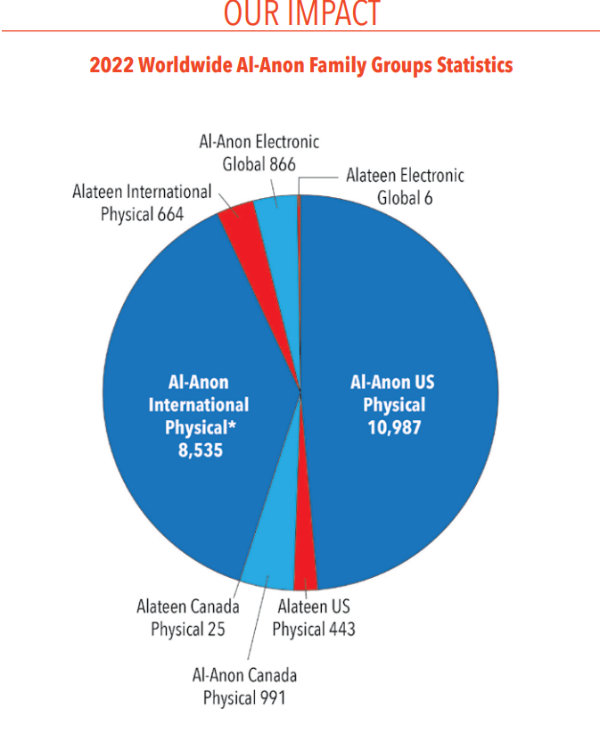
Notes:
Here are a couple of charts from the report. You can see how many groups we have in the US and in Canada, as well as worldwide. Niketa, shared that they have 891 groups in the GEA with 1,468 meetings. Most of the services are group services, including answering the meeting line, registering groups, supporting registering groups, the mobile app, supporting Alateen groups, supporting information service centers, maintaining archives, and the international.

Slide 29
More Annual Report
Community Relations - Heather
Working with recovery professionals
Programs – Sarah
Group records
Public Outreach biannual meetings
Continued support for GEA
Alateen - Sue P– Spanish long-timer panel at International
Conference Leadership Team (CLT) - Suzanne
Conference
Typo on pg 13 of Service Manual: step 3 and 11 – God is italicized
Notes:
Some more reports. Heather is working with a variety of recovery professionals and events to continue to educate what Al-Anon is. Sarah is the head of programs, overseeing groups records which has been incredibly busy with the transformation of electronic groups, meeting with public outreach coordinators on AFG Connects, continuing to work with and support the Global Electronic Area, working on Alateen re-certification – little plug for Jan – get your amias forms to her asap. And Suzanne reported on the Conference preparations. She made amends for a typo in the service manual. On page 13 in the new Manual, in steps 3 and 11, the word “God” is italicized. This is a little thing but it is an error. That word is not meant to be italicized. That is corrected on the online version but not in the current paper version.

Slide 30
More Annual Report
Literature – Tom
New book – will ship July 5
Alateen bookmark is being translated
1st draft of Gems Booklet from the Dilemma of the Alcoholic Marriage
Forum – 19,052 subscriptions!!
International Structures - Tanya
IAGSM
Meet regularly
Town Hall Meetings
Notes:
Tom (pictured) is our Literature chair and he reported that you will be able to place advance orders for the new book soon. It will ship out July 5. The Alateen bookmark is completed and being translated. The Forum is up to 19,052 subscriptions!! In terms of the International structures, we had already gotten the ICC report. Tanya reported on the IAGSM and said they had determined that they needed to meet with the new and emerging structures on a regular basis and were even holding some town hall meetings with them.
Takeaway – there’s so much WSO is doing for each and every group! These are dedicated, loving individuals with a love and dedication for Al-Anon and its future.

Slide 31

Alateen Electronic Group Feasibility
Currently 5 Electronic meetings on mobile app – Pilot project
Problem – keeping Alateens safe in a global environment and keeping within the differing legal obligations internationally.
Conceptual Solution – still in discussion phase, will be presented to the Board of Trustees in July for discussion and next steps
Notes:
All right – let’s get into some information regarding Electronic Alateen Groups. First make note that are currently NO Alateen Electronic groups except for the ones on the Al-Anon Mobile Ap. There are so many things to involved in order to keep out youth safe in meetings. When you are dealing with minors over the internet on a global scale, there are many regulations and they vary from state to state, province to province etc. We do have 5 Electronic Alateen meetings on the mobile app. This was a pilot project, from the Alateen chat rooms originally. The challenge - we must keep Alateens safe in a global environment and keep it legal as well. I’m going to present the Conceptual Solution that the Project Team has come up with – it’s still a work in progress, will need to go to the Board for approval when finished. From there it will go to Conference. This is the conceptual solution. The Project Team will come up with a set of minimum safety requirements – the Global Electronic Alateen Safety and Behavioral Requirements. That is Global EASBR.

Slide 32
Proposed Conceptual Solution
Electronic Alateen Groups
All Electronic Alateen Groups must adhere to a set of minimum safety requirements – Global EASBR: Global Electronic Alateen Safety and Behavioral Requirements.
Al-Anon Members Involved in Alateen Service serving Electronic Alateen Groups (AMIAS-E) would need to be mandated reporters
AMIAS-E would need to pass a background check – no felony, charge of child abuse or accusation of inappropriate sexual behavior
At least two sponsors/AMIAS-E required at each meeting
Notes:
All Electronic Alateen Groups would adhere – some places, especially internationally, may incorporate more stringent requirement. All Alateen Members involved in Alateen Service for Electronic Groups, heretofore known as AMIAS-E, will need to be mandated reporters. The AMIAS-E would need to pass a background check, as our sponsors do now. There would be two sponsors at every electronic meeting.

Slide 33
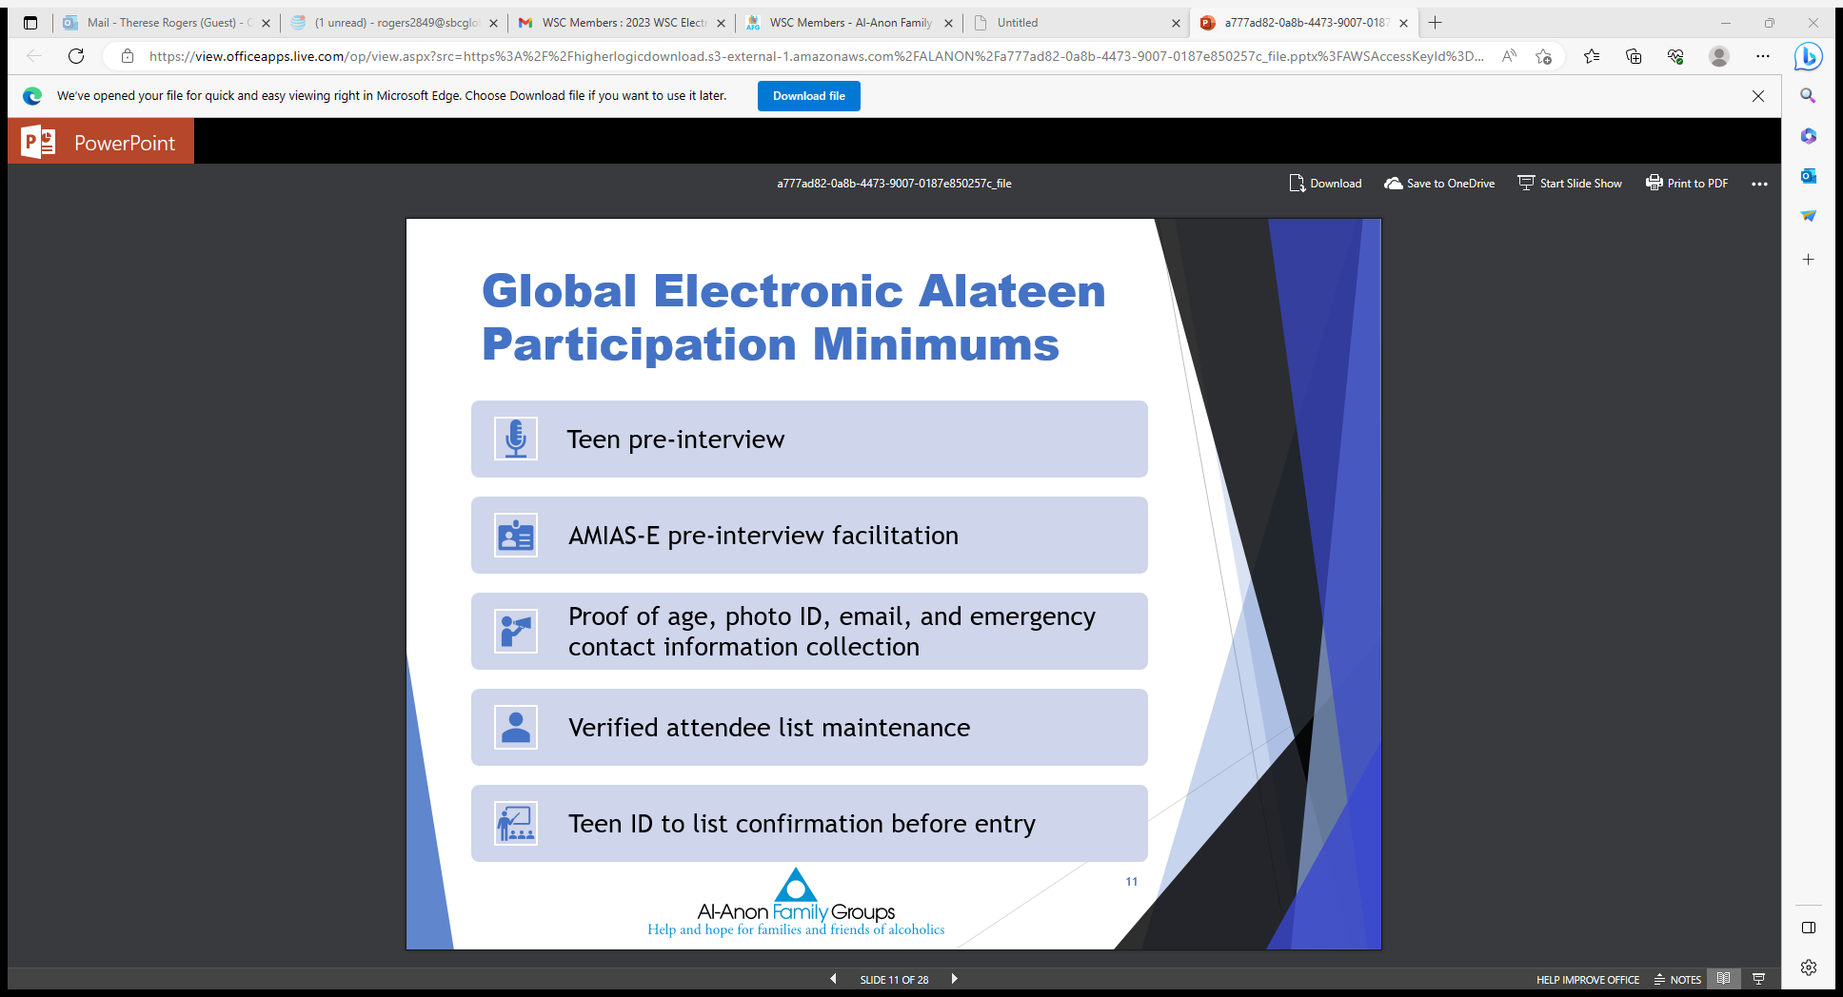
Notes:
This is new – all teens would need to have a pre-interview with the AMIAS-E, verifying their age, showing a photo ID, which could be a problem with some younger teens!, provide contact information, and share emergency contact of parent or guardian. This is all new. This is to protect the teens from anyone trying to enter the meeting that doesn’t belong. The AMIAS-Es would keep a list of those Alateens that have been interviewed and given the necessary information, then those teens would receive the meeting info. To enter the meeting room they would need to show the photo id.

Slide 34
More Electronic Alateen Group Feasibility
Meeting links would not be published on public websites, only group info and group email
Alateens must be 13 years – COPPA (Children’s Online Privacy Protection Act) is being updated
Training would be provided for all AMIAS-E
Areas would have the autonomy to decide whether to host Electronic Alateen Groups.
AT THIS POINT THIS IS ALL CONCEPTUAL;
MORE WILL BE REVEALED!!!
Notes:
The meeting links would not be published, only sent to those teens who followed the process. The Alateens must be 13 years old. COPPA is being updated so this may change. In some countries, it might be 16. The video must be on. Training would be provided for all AMIAS-E. And lastly, Areas would have the autonomy to decide whether they want to host Electronic Alateen Groups in their Area.
Again, do you need to start getting your Alateens to get photo ids?? No, this is all conceptual at this point. Understand though that this is no simple thing. So what’s the takeaway: the project team is working on the feasibility of electronic alateen meetings with the bottom line of keeping our Alateens are safe.

Slide 35

Copyright and Trademark
This is a newer challenge – it evolved with Internet and Social Media use.
Copyright – exclusive legal right to print or publish.
  Al-Anon is the ONLY one with legal right to produce CAL; this “protects the collective wisdom of Al-Anon members”.
  Only WSO can use it or permit others to use it or print or publish any material.
  Group Registration forms now include permission to use CAL in your meetings.
  Can you print it? Yes, for that meeting only, but not outside the meeting.
Trademark – our name and logos: Al-Anon and Alateen
  If logo is used for outside event, affects Al-Anon as a whole
Notes:
Copyright and Trademark infringements are becoming more and more of an issue. They didn’t used to be a problem but with the internet and social media, the world has changed. Copyright refers to the exclusive legal right to print or publish material. Al-Anon Inc. is the only one with the legal right to produce CAL; this protects the collective wisdom of Al-Anon members. Only WSO can use it or give permission to others to print or publish any material. New Group Registration forms now include permission to use CAL in your meetings. This was always understood in the past for physical meetings but WSO started putting it on the registration for electronic groups, giving them permission to screen share CAL during the meeting. You can photocopy or screen share CAL but only for the meeting, not to take home. Trademark refers to our name – Al-Anon and Alateen (and let’s be diligent about spelling it correctly!!) and our logo, the circle in the triangle. If our logo is put on an outside event that looks as if it’s sponsored by Al-Anon, that can affect Al-Anon as a whole.

Slide 36

Common violations:
  Reproducing and selling conference approved literature
  Use of logo or name on unauthorized event or social media
  Modify logo
  Websites posting Al-Anon readings along with other recovery readings
  Tik-Tok videos of reading CAL
Who has permission to use:
  Service arm events and flyers
  Registered service arm website and social media
  Al-Anon Guidelines
  Can request reprint permission from WSO
  Can photocopy or show CAL for a meeting
Read more about it – pgs 116, 117, 127, 128 in Service Manual
Notes:
What are some common violations. It is not okay to copy literature and distribute or try to sell it. You can copy it for a meeting but then it shouldn’t leave the meeting. We talked about using the logo or name with an event not connected to a service arm. It is not legal to modify the logo. We talked about the logo on the meal cards – not really supposed to do that. There are some websites that put Al-Anon readings along with other 12 step program readings every day. This is a violation and you can report those to WSO; they have a part-time person employed just to work on copyright and trademark violations. What about TikTok videos with Al-Anon readings? Nope, not legal. Most violations are simply misunderstandings or misinformation. It is relatively easy to get permission to use CAL. WSO Digital Communication department sends out CAL readings and quotes every month to registered websites. The Al-Anon guidelines can always be printed and distributed. You can request permission from WSO and it is often given. So read more about it! Takeaway – we need to protect our copyright and our trademark. We can give away everything in our program but our name.

Slide 37
August Update from The Board of Trustees
Guest Speaker:
A guest speaker presented their Ph.D. dissertation topic, titled “Does It Work If You Work It? The Therapeutic Elements of Al-Anon Participation.” Their research relied upon data from Al-Anon’s 2018 Membership Survey. The speaker focused on what other professionals would need to know about Al-Anon Family Groups. They discussed in their research that longevity in Al-Anon was a key component of better mental health. The presentation ended with a Model of Effective Al-Anon Participation:
1. Attending Meetings
2. Spiritually Motivated
3. Working with a Sponsor
4. Engaging in Service
5. Serving as a Sponsor
This presentation was well-received by the Board. We hope to see them at the 2028 Al-Anon International Convention with A.A. participation as one of our professional speakers.
Notes:
I am super excited about this information and where it might lead to. The possibilities could be endless in terms of reaching out to Health Care Proffessionals.

Slide 38


2023 AL-ANON INTERNATIONAL CONVENTION
Notes:
By all accounts the international convention was a great success.

Slide 39
A few Stats from the International
Book sales at IC2023 were amazing. of A Little Time for Myself— (B-34), our new daily reader.
Members purchased - The four-day sales figure was $152,421.
8,015 units English
584 in Spanish
29 in French.
member registration totals were:
3,387 Al-Anon,
42 Alateen,
293 A.A., and 54 guests (3,776 total in-person participants)
Plus 741 virtual registrants.
A new record was set at 4,517 registrants! Seven professionals attended as well.

Slide 40


Invite the Delegate
Notes:
Ontario South is a huge geographical area. We go from Windsor up to Minden & all the way to the Ottawa Region. Your new Executive will begin their service roles January 1st. I encourage you to invite ___________________(new Delegate) to visit, speak at your event, share their personal or their service story. Seek out the new coordinators and invite them to attend / present at a workshop. Think outside the box. How can you tap into their ES&H and share it with your groups.

Slide 41

Road Trip – You and Your Board Connect
Last year – Cleveland, Ohio 2022
This year - Southern California 2023

Slide 42



Thank you so much !
I received your cards, notes, and your gifts. They touched my heart. I felt your love and encouragement !
I am beyond grateful for the opportunity to attend Conference.
Service has enhanced my recovery and my life in more ways than I can count.
It has been a true honour to serve as Delegate for Ontario South and I look forward to supporting the New Board that you will elect later today.

Slide 43


Q & A
If time permits

