Slide 1
Virtual Assembly 2020

Slide 3
Questions?

Slide 4
This Power Point will be available on the Ontario South website shortly after Assembly.
As per request from WSO, the graphics will not be included, however they are available in the 2020 WSC Conference Summary

Slide 6
Virtual World Service Conference 2020

Slide 8
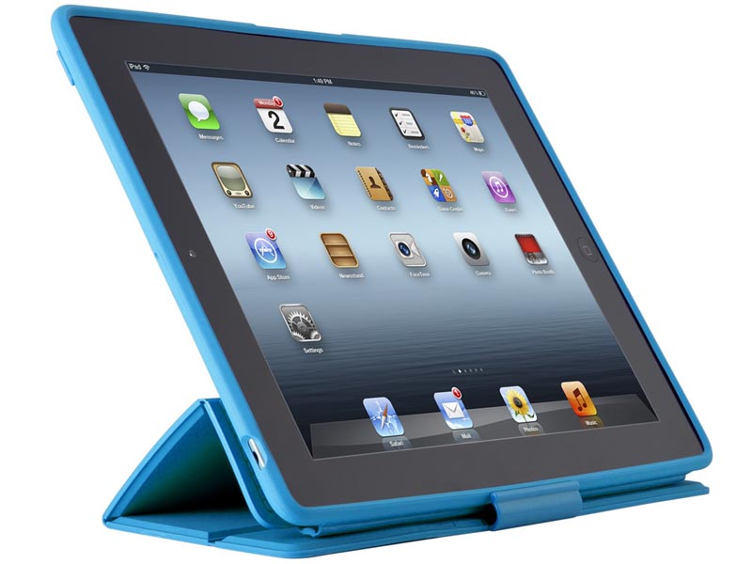
WebEx VoxVote

Slide 9
Monday, April 20, 2020 (24-hour period beginning at 7:00 am EDT)
Two agenda items were posted to AFG Connects for Conference members to participate. Each Conference member had “two-minutes” (aka 300 words or less), “one time at the mic” to share on the topic at any time during the 24-hour period beginning at 7:00 am EDT. (There were over 450 posts during the 3 days)
Electronic Meetings, Work Group (EMWG) Report
Thought Force: Identify Ways to Look at Service in
Relation to Roles, Terms, & Possible Road Blocks

Slide 10
Electronic Meetings – Work Group
Service positions in Electronic Meetings – tech person, chairperson, secretary, treasurer, greeter (for newcomers)
Electronic Al-Anon meetings are held online and over the phone.
Safety an important issue
Sponsorship can be dealt with on the chat option
Using the trademarked Al-Anon name and logo, without WSO approval, reduces our ability, as an organization, to protect our name from those who seek to profit from it
Electronic meetings (Zoom meetings not included) that sign the annual Conference approved Literature reprint license, are allowed to post the Legacies (more extensive postings of CAL is not legally supported – as stated by attorney, but will be continually explored)

Slide 11
Use al-alnon.org to search for Electronic Meetings. DO NOT use Google
WSO is web conferencing with Current Mailing Address (CMA) members, of Electronic Meetings, to discuss pressing issues.
Contributions – online to WSO
Online Newcomer welcome al-anon.org/welcome can now be used by any electronic meeting – whether it be temporary (Zoom) or permanent (the area secretary sent out a list of websites for newcomer attending our virtual meetings on April 22)
At the end of 2019 there a total of 252 registered electronic meetings (106 online and 146 phone)

Slide 12
How can we attract members to Al-Anon Electronic meetings?
Are Electronic meetings being recommended at our face-to-face and Zoom meetings and to sponsees?
Do members know how to access electronic meetings? Educate!

Slide 13
Identifying Ways to Look at Service in Relation to Roles, Terms, & Possible Road Blocks (Thought Force)
If you see service potential in a member, you may choose to make a point of encouraging them to think about the possibility of their role in Al-Anon service.
Making service positions as attractive as possible and focusing on the positive aspects of the position, could help encourage prospective members.
A Service workbook created by WSO
Service sponsorship (list)

Slide 14
Make service commitment lengths and workload variable (Coordinator teams)
Group meeting on “Service”
Leave a gap if nobody comes forward
List gifts of being in service
Have the job descriptions available for members to view
Evaluate procedures with the aim of simplifying and streamlining, while staying true to our spiritual principles.
Sponsors encourage sponsees to get involved with service

Slide 15
Service is often seen as an obligation and not an opportunity.
Fear of the unknown.
Service inventory
Service video
Co or alternate positions
“What would Al-Anon look like if people did not take service positions?”
Service is an intrinsic part of my recovery journey. Traditions and Concepts are about service thus recovery

Slide 16
Ready for lift-off of the 2020 Virtual WSC

Slide 17
Tuesday, April 21, 2020 (2:00 pm – 6:00pm EDT via WebEx and VoxVote)
Gavel was struck just after 2:00 pm EDT to open the 60th WSC
The first WSC was in 1961
12 items were discussed on Tuesday and Wednesday
2019 Auditor’s Report
2019 World Service Office Annual Report

Slide 18
Treasure’s Report –2020 Budget - The July Chairperson of the Board (COB) letter shared the impact of COVID 19 on the 2020 budget
There were 92 voting members

Slide 19
Auditor’s Report
According to Dixon Hughes Goodman LLP, Al-Anon Family Group Headquarters, Inc. is in accordance with accounting principles generally accepted in the United States of America.
Yeah us!

Slide 20
The cost to WSO, per group, per year for service is
$405.22 (CND).

Slide 22
Service is the rent I pay for my recovery but my donations are the gift I give the fellowship to assure Al‑Anon Family Groups’ survival.

Slide 23
2019 World Service Office Annual Report Highlights
As a result of requests from Al-Anon members, for a piece of CAL containing “spiritual principles”, the Literature Committee has developed a blog to allow members to share on the spiritual principles. (check it out on al-anon.org)
For members’ convenience, the “Request for Reprint” form used for seeking permission to reprint limited excerpts from Al‑Anon’s copyrighted material is now also available as an online form at: al‑anon.org/reprint‑permission
Alateen Talks- It is notable that in 2019 subscriptions increased by 25% from 1,773 to 2,218. Alateen Talks celebrated a major milestone in 2019: 55 years of the newsletter publication!

Slide 24
4. Plans to include “international meetings” in the
al‑anon.org online meeting search, by making
meeting information available 24 hours a day,
seven days a week on a platform that enables
users to view the information from anywhere in
the world, in their own languages and time
zones.

Slide 25
With the Board’s approval, the 2020 Strategies being advanced, will focus on:
enhanced trilingual communication,
expanding technology through a mobile app,
an analysis to identify ways to help the public understand why Al‑Anon is the most effective resource for recovery for those affected by the family disease of alcoholism,
addressing trademark and copyright violations to protect our name.

Slide 26
Wednesday, April 22, 2020 (2:00 pm - 6:00 pm EDT) via WebEx and VoxVote
Motions to accept (Audit Report, Annual Report, and Finance Committee Report)
Literature in Spanish and French is now available on the Online store ecomm.al-anon.org
The Al-Anon App is now available. You need to be at least 13 years of age to register for the App
The gavel to close the 2020 WSC was struck just after 6:00 pm EDT

Slide 27
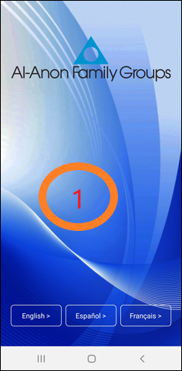
Al-Anon’s Mobile App
Begin by downloading Al-Anon Mobile App
https://al-anon.org/for-members/members-resources/mobile-app/mobile-app-guide/

Slide 28
Thursday, April 23, 2020 (24-hour period beginning at 7:00 am EDT)
One agenda item was posted to AFG Connects for which Conference members could participate.
Task Force: Reaching & Unifying Rural & Large Geographic Populations

Slide 29
Reaching & Unifying Rural & Large Geographic Populations (Task Force)
Hybrid Assembly (Zoom/WebEX)
Survey
Volunteers to go to meetings, that do not participate in service, and take survey and go back and pick it up
Contact CMA of groups not participating
Encourage DRs to visit groups
We have to know the real reasons why they do not participate
Educate during announcement time -links of service -upcoming elections
Ask each group with a GR to adopt a local group(s) without a GR – have a sign up sheet for members to choose a group they would like to adopt
If the goal is to connect unconnected people to the District and Area, we have to get the message to the unconnected people, and have an organized plan to do so and to track the data

Slide 30
Results of surveys received for Ontario South members
1. Are you as a member/group receiving information from your:
District? Yes - Doing a great job using the Links of Service
Area? Yes - Information is being relayed
If you are receiving information, what kind of information are you receiving?
Emails and notifications from GR, District, AIS, AFG Connects Area, and WSO
2. How important is it to you/your group to be connected to your:
District? 4 & 5
Area? 4 & 5

Slide 31
3. What challenges or obstacles prevent you/your group from being connected to your:
District? No Group Rep., member’s personal schedule, weather, poor internet connections, no computer, lack of technological knowledge, travel distances, lack of interest, lack of links of service.
Area? Not really on the radar, long time for responses from Area, no one to take positions
What do you/your group need or want in order to be connected to your:
District? More commitment from Group Rep., Zoom District Meetings, make sure all members know they can attend District Meetings and Assembly
Area? Visits from District Rep., and Executive members, Links of Service,

Slide 32
4. Does your group have a Group Representative (GR)? Yes
Does your GR attend District Meetings? Yes
If not, why not? One person keeps holding the position because nobody else will put their name forward
Does your GR attend Area Assemblies? Yes
If not, why not? Don’t have a GR
5. Does your District have a District Representative (DR)? Yes
Does your DR attend Area Assemblies and/or Area Meetings? Yes
If you don’t know, ask them.

Slide 33
6. If distance, time, or money are obstacles to participating in service, how much of each is reasonable in order for your Group Representative to attend a:
District Meeting? Reimburses $20 for gas, Zoom has made attendance easier, group autonomy, weather and nighttime
Area Assembly? Group saves money during the year to send GR to Assembly, gives GR money for meals, gas, registration, and hotel
7. Would you or your Group Representative be willing to participate in a District/Area meeting using a phone or a computer/tablet (teleconferencing or online conferencing)? Yes - Would prefer to meet on line, personal connections are missing with Zoom

Slide 34
8. Any other comments or suggestions? Contact information for Executive and coordinators available on website, avoid Assembly on same weekend as other Al-Anon events, use SurveyMonkey format for questionnaires, Can a District, that does not have a DR, merge with another District ? Keep using Zoom, Zoom has pushed me in technology and thus attending District Meetings and Assembly, educational piece or material for groups to give to newcomers about the roles and responsibilities for Districts and Area, condense the budget information
9. Do you have reliable internet or phone services? Yes

Slide 35
Friday, April 24, 2020 (24-hour period beginning at 7:00 am EDT)
These three agenda items were posted to AFG Connects for Conference members to participate.
Chosen Agenda Item: How is Al-Anon going to reach new members in the 21st century and the millennial generation?
Thought Force: Fear of Change
Chosen Agenda Item: Our Envisioned Future sees Al-Anon being a global organization with barrier-free access to the program. How do you see this manifesting?

Slide 36
How is Al-Anon going to reach new members in the 21st century and the millennial generation? (Chosen Agenda Item [CAI])
Keeping in touch with professionals is important.
PSAs that are done in a “gaming" or "anime" style
Groups could have virtual speaker meetings

Slide 37
CAI cont’d
Less words and more action
Perhaps we could avoid using the word YOUNG members. We want to attract NEW members
Create a DVD that teachers and counselors could show to students telling their stories to help them connect with our purpose
Links of service for electronic meetings
It’s not about changing our program, it’s about how do we communicate. Change our attraction strategies. Questions like “Are your friends drinking too much?” “Is life in your dorm a mess?”

Slide 38
Fear of Change (Thought Force)
Encourage understanding. It’s okay to ask a question.
There is always time for another question
Consensus
Being open to others and considering their beliefs and opinions without preconceptions
Reason for our resistance to change is often Fear which is sometimes covered with anger
Trusting that no matter how the issue proceeds, the outcome will be okay if we have trust in HP
How could we address “fear of change” in a way that could be positive?
Many voices, One Journey pg. 391
Talk to each other reason things out with one another.
Recent changes have created Fear > Faith

Slide 39
Fear cont’d
Al-Anon is a safe place to face fear
Being in Al-Anon is all about changing ourselves
Very little is new in Al-Anon
Knowing I am not alone
We need to be open to change if we want our program to grow
We can always address current issues by doing what we have always done
What I do is NOT wrong
What is the threat?

Slide 40
Our Envisioned Future Sees Al-Anon being a Global organization with barrier-free access to the program. How do you see this manifesting? (Chosen Agenda Item [CAI])
Today, approximately 40% of our groups exist outside the WSC Structure (other parts of the world). The creation of an actual worldwide group conscience is not only desirable but imperative. All voices must be heard. How to make Al- Anon a truly global organization is a difficult task.

Slide 41
Our Envisioned Future (cont’d) How do you see this manifesting?
We have to release everything coming from WSO in all three languages simultaneously (English, French and Spanish). We have to start thinking as ONE.
We must expand our electronic availability to match the current culture to ensure barrier free access. We need to invest financially in current platforms and keep up with them as they change.

Slide 42
CAI cont’d
We need to support the WSO financially to enable them to assist other countries when they are ready to create their own General Service Office
We need to include the people from outside the WSO structure to get input.
Concerns:
If we venture into a global structure, we may run the risk of spreading ourselves too thin.
As long as our membership continues to dwindle, we need to confront that problem and not use global Al-Anon as a diversion.

Slide 43
Sharing Area Highlights
California North
California South
Delaware
Georgia
Mississippi
Montana
New Jersey
North Carolina and Bermuda
Vermont
West Virginia

Slide 44
Canadian Delegates
Met via Zoom on Saturday, June 13
Discussions were mainly about the challenges of COVID-19 and the unstoppable members of Al-Anon who found ways to meet via Zoom.

Slide 45
Al-Anon’s Blog
Al-Anon’s Blog is a place to share experience, strength and hope with other member.
https://al-anon.org/for-members/members-resources/member-blog/

Slide 46
WSO Financial Update
The response from the members, groups, Districts, and Areas to the Special Appeal was so appreciated. The Finance Committee continues to keep a thoughtful eye on expenses, and they wish to thank the Staff for controlling their expenses. Although the contributions were above the budgeted amount for June, WSO is not out of the woods. There is still a projected deficit of $420,000 through the end of December 2020. Please continue your contributions to WSO if you are able. Send contributions by check to Al-Anon Canadian Headquarters Inc. 275 Slater Street, Suite 900 Ottawa ON K1P 5H9, or go to the website: al-anon.org and look for “Contributions”

Slide 47
WSO Policy Committee
One of the items at the July 2020 Policy Committee meeting was:
A new, soon to be assigned Thought Force, to discuss National and International Public Outreach Concerning Social Media.

Slide 48
2021 World Service Conference theme
Moving Forward with Unity, Courage, and Perseverance
Avancemos con unidad, valor y perseverancia
Allons de l’avant avec unité, courage et perseverance
How might you, your group, your district, and our Area incorporate and use this theme in the coming year?

Slide 50
It takes a fellowship. Each one of us. Each one of us needs to donate when we can, serve when we can, share honestly when we can, dream big when we can, pray and meditate when we can, bring along someone newer than us when we can, listen to someone who's not as crazy as we are when we can.

Slide 51
I MISSED THE HUGS, BUT FELT THE LOVE
Notes:
Encourage service. Talk about Delegate’s role

