Slide 1
Ontario South Area World Service Committee

Slide 2
DELEGATE AWSC REPORT From 62nd Annual World Service conferrrence
Ontario South Assembly, Area 86
Panel 61, Gwen Dinel
Notes:
Hello, my name is Gwen Dinel, and I am member of the World Wide Fellowship of Al-Anon which includes Alateen & my Home Group is Al-Anon Works Wednesday at 7:30 PM in London. In my current Service Role I am the ON South Delegate Panel 61, World Service Conference.
I still can’t believe that I GET to do this. I am humbled and thrilled to be of service to Ontario South Al-Anon & Alateen.
So, a big Hello my Al-Anon family !!!
I had no idea that when I came into the rooms all those years ago, broken, angry, lonely and defeated that I would be here before you today. I love Al-Anon & Alateen and my prayer is that it will forever be available to all who want it.
Service and paying it forward is how we can do that, Service has transformed my life in so many ways.

Slide 3
Mail started to arrive…and it kept coming
It cam from all over Ontario South and all over the US.

Slide 4
Thank you for your cards and love gifts
Notes:
The first think I want do is say a heartfelt thank you to all of you! This is a picture of my table at my home, full of the cards that were sent to me prior to and during conference. I was overwhelmed with all the love gifts I received from groups and districts all over Ontario South, Canada and for that matter the world. Also I received some texts and emails during the Conference, reminding me of your support. I can honestly say that I brought you with me to New York. I was and continue to be very aware of my responsibility as a delegate. When I felt overwhelmed or unsure I would be reassured that I was not alone. Your emails, texts and cards came at exactly the right time. I know it may sound hokey, but your love & encouragement truly were the Wind Beneath My Wings !

Slide 5
US vs Them…
Family Groups VS WSO
They ARE Us
&
We ARE Them
“You can take this back to your groups”
Notes:
So I have much to share with you but I can’t share all of it. I was in meetings for 5 days so I need to chose the topics that I believe relate most to Ontario South. The good news is that You will be able to read about the entire conference when the Conference Summary is sent out later this summer.
As District Representatives it is for you to take this back to your district tables and share with your GR’s and your Coordinators. There will some parts that are more relevant to your district than others.

Slide 6
Enhancing our Recovery through Abundance, Unity and Understanding
World Service Conference
April 27-30, 2022
COMTEMPLATIVE
FORWARD THINKING
POWERFUL
FUN
HISTORIC
SPIRITUAL
INSIGHTFUL
UNIFIED
EXHAUSTING
Notes:
Our theme for this World Service Conference was Enhancing our Recovery through Abundance, Unity and Understanding – a great theme. Since it was a trilingual conference (English – Spanish & French), this theme was also in French and Spanish and there were interpreters present.
What are some of the words I can use to describe this Conference week?
Powerful, spiritual, fun, exhausting, forward thinking, contemplative, historic, Exciting & sometimes Overwhelming.

Slide 7
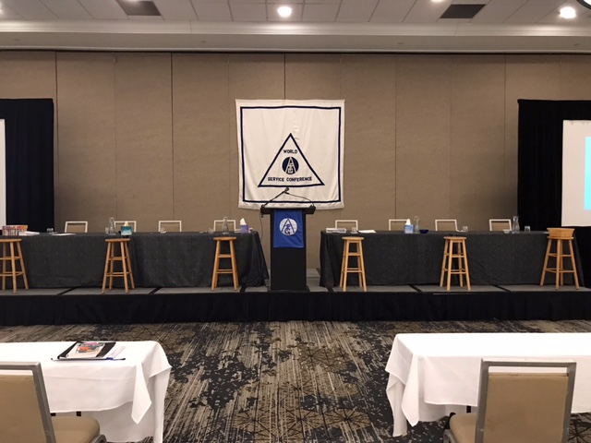
World Service Conference Who Attends?
Delegates
Board of Trustees
At Large Members of the Executive Committee
Members of World Service Office (WSO) Staff
Notes:
The World Service Conference! Or as shall be known heretofore as the WSC or Conference!!
This is what our room looked like for Conference.
So WHO was there?
Delegates from the United States which includes Puerto Rico & Hawai and Canada.
The Board of Trustees,
The Executive Committee which includes some At Large members.
And members of the World Service Office staff – both voting and non-voting members. There was a total of 87 voting members at this Conference.
The Attendees :
66 Delegates (two of the 68 Areas were not represented due to illness)
11 Trustees
3 At-Large members of the Executive Committee
7 WSO Staff

Slide 8
World Service Conference, What Did We Do?
Motions
Talks
Presentations
Chosen Agenda Items
Discussions
Stepping Stones
Al-Anon meetings
Connect to other delegates, board members, and staff
We were busy! We had Fun ! We Listened & Learned!!!
Notes:
And what did we do?? There were several motions to discuss and to be voted on. I was bearing witness and participating in the spiritual nature of the Legacies at work. There was background provided for each motion (the same as we will do here this weekend). There was mutual respect, really hearing each other with open mind and open hearts. There was discussion and questions. And only then was there call for a vote.
Each Delegate of Panel 60 (they are serving their last year as Delegates) had an opportunity to share about their time in Service as a Delegate.
WSO Staff Members gave reports. They are so dedicated and They are so incredibly passionate about their work.
The annual Report – By the Executive Director
2021 Auditor Report – by the director of Finance
Electronic Meetings Becoming Al-Anon Family Groups (And therefore becoming part of the Links of Service) History in the making!!
– Director of Programs, Dir of Finance & Operations, Dir. Group Services & Dir. Brand Communications
Mega Issue – What skills are needed to serve as a Trustee?
Chosen Agenda Items.
Open Policy Meeting -We were able to observe a Policy Committee Meeting and a Board Meeting. Turns out I loved the Policy meeting and could see myself being a part of that some day far away.
Thought Force Presentations and Task Force Presentations. I’ve learned a lot and could see Ontario South implementing these into our processes.
Chosen Agenda Items; we had discussions about other issues;
We visited Stepping Stones. I will share more about that later.
At the end of each day generally close to 8:30 there was time for any unanswered questions or reflections from the work we had covered that day.
There were Al-Anon meetings at 6:00 am and 8:45 (or when we were done working) pm every day.
Meal times were an hour long and gave us the opportunity to connect with other delegates, board members and WSO staff during meals and breaks.
I was busy!!! I had Fun!! I Listened & Learned and I was Exhausted in the best way.

Slide 9
Global Electronic Area
First Motion – PASSED!! Round of applause
674 Electronic Groups (March 2022)
Physical and Electronic Groups
A Group is a Group is a Group.
Physical or Electronic can be identified
Notes:
The Global Electronic Area!! This was huge, this was historic and you need to take this back to your groups!!
The very first thing that we did as conference members was to vote on a motion.
The motion was to admit into our World Service Conference structure a new Area – the Global Electronic Area.
Al-Anon has not admitted a new Area since Alaska was admitted in 1987.
This past January The Global Electronic Area had held an assembly and elected a delegate, his name is Ozzie.
Poor Ozzie had to wait outside while we discussed and voted. The Motion was presented followed by a lot of discussion. Some changes were made to the original motion and more discussion followed. And finally the vote. Then we had some technical glitches with our voting system. Poor Ozzie was out there in the hall for quite a long time.
Finally technical glitches were fixed and the vote was taken and tabulated. Motion Passed !! Al-Anon added the Global Electronic Area to our Structure!! Huge Round of applause!! When Ozzie came in, the standing ovation lasted a long time and he was not the only member in tears! This was a Historical Moment,
Electronic meetings have been around for a long time, over 15 years, but because of our Motion last year, they are now Electronic Groups! And as Groups they are now part of our Service Structure. There were 674 electronic groups as of March 2022. These Electronic Groups are now known as ??? Add the #
For now we will be called Physical groups and Electronic groups. That means that a group is a group is a group, whether it’s physical, in a geographic location, or it’s electronic in a non-geographical location.
As Ontario South moves forward ( here’s where a thought Force comes in) we have the option to admit or not admit electronic groups. There are many questions to consider as we move forward. World Service Group Records can list both physical and electronic groups.
So – What would that look like?

Slide 10
Global Electronic Area cont.
WSO will register Electronic groups still.
A group CAN NOT have a physical location AND an electronic location.
A group can be a physical group with an electronic component into that physical group (what we think of as hybrid). That group is part of our Area.
Our job – get our procedures in place!
Notes:
I’m going to do my best to explain this process. It can be confusing
If members wants to start a new Electronic group, WSO will register them. This cannot be done by our Group Records Coordinators yet, but soon.
That group will choose if they want to be a part of the Global Electronic Area or a Geographic area.
If they want to be a part of a Geographic area, that area must have processes in place and have let WSO know they are ready and willing to accept Electronic groups.
This is important. A group can NOT have a physical location and an electronic location.
So we have a group that has a physical meeting – face to face – one day and an electronic meeting another day. They are separate Groups with individual Group numbers.
The group is either physical or electronic; it would be the same thing as trying to list a group as meeting in one place one day and a different place another day. From a group records perspective it doesn’t work; There must be a single location .
HOWEVER, let’s say the physical group has a face to face meeting with an electronic component –(This is what we have been referring to as Hybrid), Some call it roomies and zoomies. Those meetings can continue as usual.
That group is a considered a Physical group because it has a physical meeting location.
Next Steps:
Decide how Ontario South wants to proceed. Do we want to accept Electronic Meetings into our Area?
If So, what we need to do?
We would need a thought force to examine and present how to include those groups into our Service Structure.
There are other Areas that have been walking through this process for a while now and are ready to receive Electronic Groups, there are also areas that are in same place we are.
Al-Anon has grown its number of Areas by 1. I am sure this is only the beginning.
WSO has been working hard on this, making this happen, revamping the group records database, url, forms as well as meeting with the GEA (Geographical Electronic Area) on a weekly basis at times and sometimes multiple times in a week.
So - What does mean??? “ Al-Anon’s Circle just got bigger”

Slide 11
Notes:
I’m grateful that part is over! Feel free to ask questions if you want at the end – I will do my best to answer. The main takeaway I want you to have – The financial director and the Board Treasurer are diligent with member’s contributions. WSO works really hard and they account for every penny making sure it goes towards Al-Anon’s mission of helping families and friends of alcoholics.

Slide 12
Where are we now ?
This Photo by Unknown Author is licensed under CC BY-SA
Notes:
Ok, Here we go, its time to look at our financial health.

Slide 13
Financial audit for 2021
Notes:
This is the part that made me the most nervous. I am not an accountant!! Thankfully I don’t have to be. Every year there is financial audit done by independent firm for WSO. The independent firm rendered an unmodified opinion – that’s as I understand it the best you can get. They confirm that everything was above board and just as the financial ledger indicated.

Slide 14
Money
Disclaimer
Audit
Clean opinion
Statement of Financial Position: Total Assets: $13,783,274; Liabilities $1,497,267; Net Assets $12,286,007 in 3 funds: General, Reserve, and Building.
Statement of Activities:
Total Revenue: $5,173,609 (Literature sales $1,906,751; Contributions $2,623,242)
Total Expenses: $5,214,815
Net Assets End of Year: $12,286,007 (all three funds)
Reserve Fund – the net value is $3,607,414 – 8.5 months of operating expenses.
Notes:
Okay disclaimer! I needed help for this and pray I get through it. I can tell you I understand it better than last year. I sat in on a class with our WSO Dir. Of Finance. Nicky was so helpful and un-muddied the water for me.
I can get lost pretty quickly in profit and loss, cash flows, liabilities, unearned income – whew!
So buckle up because here we go.
Al-Anon Family Groups Inc. is audited annually by an independent firm.
The best outcome is a “CLEAN OPINION” and that is what we received.
Here is the Statement of Financial Position for 2021. Our total assets were $13.7 mil, our liabilities for $1.49 mil, our net assets $12.2 mil and that is within three funds, the General, the Reserve and the Building fund.
So now the Statement of Activities: Our revenue for 2021 was $5.17 mil, with Literature sales at 1.9 mil (still less than pre-pandemic years $2.9 in 2019), contributions $2.6mil. Our expenses were $5.2mil. The difference of revenue and expenses was a deficit of $76,000. This would have been much higher but member contributions were up and WSO costs were down. Our total net assets at the end of the year was $12.28 mil – this includes our reserve fund, our investment income (with a gain of $1.8 – it was a good year for investments), and our building fund.
Our reserve fund NET value was $3.6 which is less than our one year operating expenses of $5 mil. So our reserve fund is 8.5 months of operating expenses.
If you have any questions that I cannot answer please email me your question with WSO Fin Question in the subject line and I will seek out the answer and respond to you.

Slide 15
More About
Budget – Deficit Budget
Projected Revenue $5,460,061; Projected Expenses $5,813,175
Deficit $353,114
As of March 31, 2022, we already see a $244,000 deficit.
Special appeal will be sent
Contributions: 2020 $3.2 mil; 2021 $2.6 mil,
2022 $2.8 mil ??
Only 51% of groups contributed
Each group $281.88 = $3.9 (51% = $2.0 71% of budget)
Notes:
So let’s talk about our Budget.
We are currently operating in a deficit budget. Let me be clear about this. We is US ! Yes You & Me, Our Groups, Our District all members – all of US this is our budget.
It is very important that we know this and we do our best to take responsibility for it.
WSO wants to return to providing the services that are needed. During the Pandemic many services were reduced or set on hold. We have all felt the loss whether it be in Group Services, or Literature or whatever.
The projected revenue is $5.4mil and the projected expenses is $5.8mil. That’s a deficit of $353,000.
As of March 31, we already have $244K deficit of that predicted $353k so it may increase as the year goes on.
WSO will be sending out a special appeal to groups.
Contributions are projected to be $2.9 mil, compared to $3.2 mil in 2020 and $2.6 mil last year. Only 51% of groups contributed, I think this is similar to what we see across Ontario South.
We received a sheet outlining expenses per group per year.
The total expenses divided by the number of groups $281.88 per group.
Therefore If every group donated that much, we would have $3.9 mil! If only 51% of groups donated that amount, we would have $2 mil; that would be 71% of our budget. So take that back to your groups - $281.88 would be an amount to strive for. Please share this with your Group Reps and encourage them to share this information with their groups.
Here is what Ontario South donated in 2021: 41% of groups donated; the average group donation was $272.61; The total for Area donations was $41,053compared to $37,662 in 2020. The average US group donation was$ 174.5 , and the average Canadian donation was $175.04.

Slide 16
Where is Ontario South in this equation? Donations: 41% of groups contributed to WSO. Average group contribution - $272.61 2020 Contributions – $37,622 2021 Contributions - $32,440 Why is this important to know?
Notes:
41 % of the groups in Ontario South contributed to the WSO in 2021

Slide 17
What do our contributions do?

Slide 18
What Services Does the Budget Provide For???
Registering Groups
CAL
Mobile App
PSAs
Questions / Concerns Regarding Meetings
Questions and Concerns in General
Translating Literature
Supporting International Structures
Trilingual Online Store
Forum, Le Lien, en Accion
WSC
Interpretation
Alateen Recertification
Protecting Al-Anon’s Name / Brand
Website
Updated and Translated Guidelines
Membership Survey
Salaries, Building Expenses
Notes:
I want to assure you, that the WSO staff work HARD and with so much passion and dedication to provide the services we expect from WSO as well as forging ahead to provide future needed services, as we’ll see when we look at the new Strategic Plan. They have been working 150% at less than 100% capacity.

Slide 19
Please take back to your group
Thank you for your contributions! They are necessary to provide the services WSO offers to groups. “Together we can achieve our primary purpose of helping friends and families.” Cindy M.
WSO continues to need your contributions as we navigate our way past the pandemic and restoring services impacted by the effects of the pandemic.
Buy a book! Literature sales will increase both WSO and Area finances.
Know that all financial decisions and actions are guided by spiritual principles and the Finance Committee strives to keep all the legacies present in all discussions.
Notes:
So here’s what you can take back to your group.

Slide 20
Hang in there
I know this is a lot but we’re getting there.

Slide 21
Projects for this year
The new daily reader
“A Little Time for Myself”
New Service Manual Now Available Free Online Printed Version Later this Summer
Electronic group database transformation – significant
1st Longitudinal Study
Meet the Board Event in Cleveland in October
IAGSM in London in October
Returning to in-person Board Meetings
Hire staff – Associate Director - International
Notes:
Here are some projects they will be working on this year; these things were taken into account when developing this budget.

Slide 22
Longitudinal study
Competitive Analysis for membership survey
Recommended Longitudinal Study
10 questions for 5 to 10 years
“generate valid data and insights to demonstrate to professionals the long-term impacts of attending Al-Anon”
For those who Opted in during the Member Survey, some members will be chosen and contacted to participate in the Longitudinal Study.
Notes:
I shared this information last year. This year I am excited to say that I have bee one of many chosen to be a part of this study. It is directly related to our Public Outreach goal of expanding our visibility with Doctors, Phycologists and Addiction Counselors / Mental Health Professionals etc. The goal is to help them recognize Al-Anon as an effective and sustainable resource for those individuals who have been affected by the family disease of alcoholism. The research professional group suggested that since a “control group” was not really viable a longitudinal study might show the impact of long-term Al-Anon membership. This motion passed to conduct a long-term study of 5 to 10 years. So please take back to your group members to watch for an email from WSO if they agreed to be a part of the study. The participants have been randomly drawn from those who opt in.

Slide 23
Notes:
I’m grateful that part is over! Feel free to ask questions if you want at the end – I will do my best to answer. The main takeaway I want you to have – The financial director and the Board Treasurer are diligent with member’s contributions. WSO works really hard and they account for every penny making sure it goes towards Al-Anon’s mission of helping families and friends of alcoholics.

Slide 24
The Home of
Lois and Bill Wilson

Slide 25
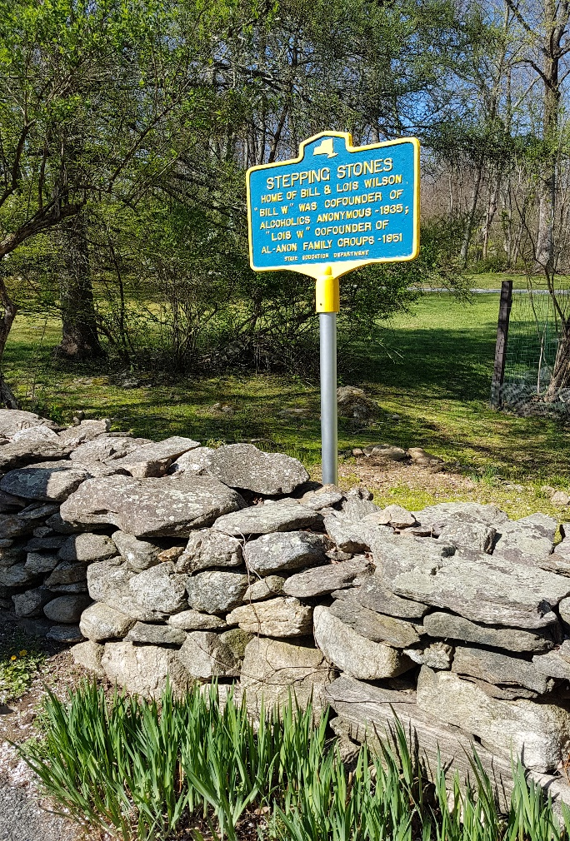
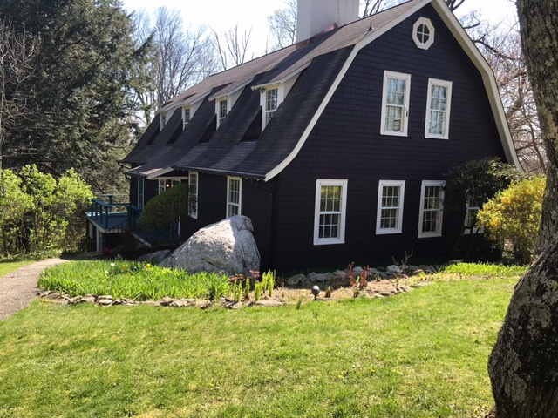
Stepping Stones
steppingstones.org
Notes:
Let’s all breathe for a minute!! Thank you! So Thursday morning we all boarded buses and came to where Al-Anon the organization really took flight – Stepping Stones. You can explore it yourself at steppingstones.org - Please share that when you go back to your groups. There is a foundation that serves as caretaker of this historic home. All over the house you will see Lois’s hand and heart, from the flowers she tended to all the coffee cups displayed in the tiny kitchen to the typewritten cards labeling the many photos on the walls. It was a wonderful experience and I am so grateful that I was able to go.

Slide 26
Let’s Talk Trustees
Mega issue
Trustee Chosen Agenda Item
Regional Committee on Trustees
New Trustees
Jean L and Sally K
Anna Marie Z and Pennie K
Kathi M, Trustee at Large – coming in November
Notes:
Okay, let’s talk a minute about the Trustees – these are the volunteer members who serve on the Board and are the guardians of the Traditions. We have Regional Trustees and Trustees at Large. There are several vacancies and some of those affirmed this time are completing another’s term. There are just not enough people submitting resumes for trustee! You do not have to have been a delegate to be a Trustee but it is a rather rigorous application process.
The mega issue discussed was whether a skill based description for the trustee role would be more helpful than the current resume application.
The Chosen Agenda Item was to discuss the advantages and disadvantages to having Regional Trustees AND Trustees at Large.
Trustees at Large, although Regional Trustees must go through an Area process before submitting to WSO. So if you are thinking of applying for Regional, get with the officers now!! We did affirm some new trustees at the Conference: Jean L will serve a second three year term, Sally K from Canada West will serve the first year of a remaining two year term, Trustees at Large include Ann Marie Z and Pennie K, first year of a three year term.
Later this afternoon we will have an opportunity to hear a report from the Canada Central Regional Trustee.

Slide 27
Annual Report
Strategic Plan
WSO staff
Vacancy – Associate Director - International
Annual Report and Updates
Notes:
The Annual Report is so big, so huge, I don’t quite know how to get it all in! The report itself is 50 pages and what was presented at the Conference were the updates as of March!! I love the Annual Report because each staff member gets to share what they are doing in their department. When they reported at Conference you could see their enthusiasm and dedication in all they do. You will find everything you want to know in the Annual Report, what books are selling the most, the total number of groups, all the work that has been done this past year, I’m even in the Annual Report – I was asked to write an impression about getting some Alateen submissions for the Alateen Just for Tonight bookmark. The Annual Report will be available soon on the al-anon.org website
The Strategic Plan has been updated so I hope you all got a copy of it. Let’s read it! Mission Statement. This is a revision of the previous Strategic Plan and everything that is in the Annual Report relates to one of these goals or the previous plan. Vali said think of this plan not as a road map but more a GPS, it’s dynamic and changes as we go along. I don’t know about you bu my GPS is always “recalculating”.
Sarah S is a new staff member, the Director of Services and she shared a little of her journey from Alateen to working at the WSO. There is an opening for an Associate Director – International if any of you would like to relocate to Virginia Beach for your dream job with WSO!
So lets quickly talk about what’s been going on at WSO and there is a lot.

Slide 28
Annual Report and Updates
Updating guidelines
Exploring payment options
Program services
Digital Communication
Group Services
Conference
Literature
Marcia – Former Dir. Of Programs
“I never dreamed when I married an alcoholic, this is where I’d end up!”
Notes:
They are continuing to update the guidelines, those that are updated have a blue banner on them,
They are exploring other payment and contribution options – no details yet
they have made significant changes to the database, they have fielded many calls regarding face to face/hybrid/electronic meetings, both constructive and destructive criticism; at times the spirit of al-anon kindness was missing.
Digital communication – updated mobile app, has a new interview in Spanish on the youtube channel, continuing social media presence, posters are available for free download,
Group services – supporting Alateen and areas working on recertification = we’ll talk more about this in a minute but it’s taken a lot of time. Also working with the Global electronic area, providing support on a regular basis
Preparing for this conference!
Literature- received 100 submissions for Alateen bookmark, working on forward for Dilemma, sent calendar quotes, and more! the new daily reader is being translated
Saying goodbye to the Director of Programs.
Remember back when I shared about US – VS – Them, and then what the WSO does for AFG…Well he are some tangibles.

Slide 29
Workshops and Presentations
Encourage Service Participation
Service Inventory
Diversity Today – Thought Force
Maintaining a Sustainable Future Using Abundant Thinking
Delegate led presentations on workshops from last year
Notes:
There were workshops and presentations by task and thought forces. The Task Force on Encourage Service Participation came up with a Service Inventory. The Diversity Today Thought Force presented a skit that brought up many questions to think about. The Maintaining a Sustainable Future presented ways to practice the Seventh Tradition with spiritual principles. And three delegates were asked to present their experience on giving the workshops from last year. Lot of great ideas and fun ways of sharing them.

Slide 30
Policy Motions
Social Media
clarifying
Conference Charter
allow for non-geographic area
Notes:
We passed two policy motions. One had to do with the wording in the Service Manual on the Social Media, found in the Service Manual on p. 125. The new wording is much more comprehensive and much clearer. Then we passed a motion on making housekeeping changes to the Conference Charter, found in the back of your service manual p. 224, to update it in regards to the new global electronic area.

Slide 31
Alateen
Supporting Alateen
Electronic groups
Decertification
Notes:
Let’s talk about Alateen. There were three different sessions regarding Alateen. First, we just had a Chosen Agenda Item about rebuilding Alateen after the pandemic. What surprised me was that there are several areas that don’t have any Alateen groups in their area at all and are struggling in the same way that we have been struggling here.
Second we had a presentation and questions regarding Alateen Electronic Group Feasibility work group. There are 6 members and this work is ongoing. There is no easy solution for keeping Alateens safe in a global world, especially when laws are different across states and provinces. So for right now, Alateen is not included in the Global Electronic Area.
And lastly, the Group Services team updated us on the Alateen Recertification Process! Last year 11 areas did not meet the recertification deadline, despite reminders up to the deadline. Although extensions were given the last two years, the WSO felt they had to honor the 2003 Motion Areas must recertify every year. What happened when an area missed the deadline, they were decertified and they could no longer use the Alateen name, they could no longer hold any Alateen meetings or have Alateens at any events. Alateens could join Al-Anon meetings. Then the area had to start from scratch, develop Behavioral and Safety guidelines and have them approved by legal counsel and then by WSO. And many of the laws regarding minors have changed since 2003 so recertifying was a huge nightmare for many.
I want to thank out AAPP and Alateen Coordinators for their service and dedication to Alateens in Ont South.

Slide 32
International Coordination Committee
International Al-Anon General Service Meeting - IAGSM
Zonal meetings
Notes:
When I first read this title I pictured a lot of nimble people in a room doing difficult yoga poses.
Hold on though, That’s not what this is. However we are on the downward slide!!
The International Al-Anon General Service Meeting will be held in London England with Al-Anon General Services from all over. And the ICC attended Zonal meetings to connect with established General Service Structures and evolving service structures. I thought it was so “cool” that a group was started in Antarctica and they reached out for support. And Russia now had a General Service Structure.

Slide 33
You and Your Board Connect
Cleveland, Ohio Oct 2022
Requesting bids for 2023
TEAM event was discontinued
Notes:
You and Your Board Connect is a chance to meet with Board members for an event. The one in Cleveland, Ohio has been cancelled twice but we’re hoping the third time’s the charm!! See me for details. Other areas can put in a bid – we can if we want to for 2023. and the TEAM event is no more.

Slide 34
Let’s go!
Road Trip – October 2022 – Cleveland OH
Albuquerque, NM - June 29-July 2, 2023
Watch for Area/Group announcements for in person events…Great opportunity for a road trip.
Gather a group together for an electronic event if it is safe to do so. Make a day of it, share food and fun.

Slide 35
2023 Al-Anon International Convention
Albuquerque NM
June 29-July 2, 2023
New Hopes, New Friends, Renewed Recovery
Notes:
Are you still with me?? Let’s go to the International!!! Albuquerque, NM in July 2023! “A Little Time for Myself”. Take this back to your group – start saving your pennies now! This is not a service event. This is an opportunity to connect, make new friends, hear speakers from around the world, share laughter, tears & recovery. I have never been to an international so I’m sharing this second hand.

Slide 36
What’s coming up? Where to look ?
Events – Can be Found on our Area Website
Cleveland, Ohio Oct 2022
World Service Conference – April 20-23, 2023 in Virginia Beach!!!

Slide 37
DISTRICT VISITS!!!
Ontario South is a huge area.
I would love to visit every district however that would be difficult for me to do, especially during the last 2 years.
I am available to visit electronically and in person as timing permits.
Please, invite me to a group meeting, a district meeting or your Al-Anon day celebration
Notes:
Please invite me – I’d love to come !!

Slide 38
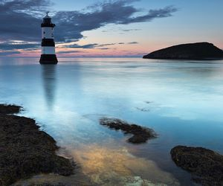
It is in letting go that we receive
Notes:
What I really wanted to let go of was Fear: My Fear of not being good enough, my fear of letting the members of OSA down, my fear of getting it wrong. In the end, I was able to see clearly that was all EGO. I was also able to see what this experience really was. It was a conversation between members. Very similar to the ones we have at our Group Business Meetings or our committee meetings or our district meetings. Perhaps just on a larger scale.

